Slide 1
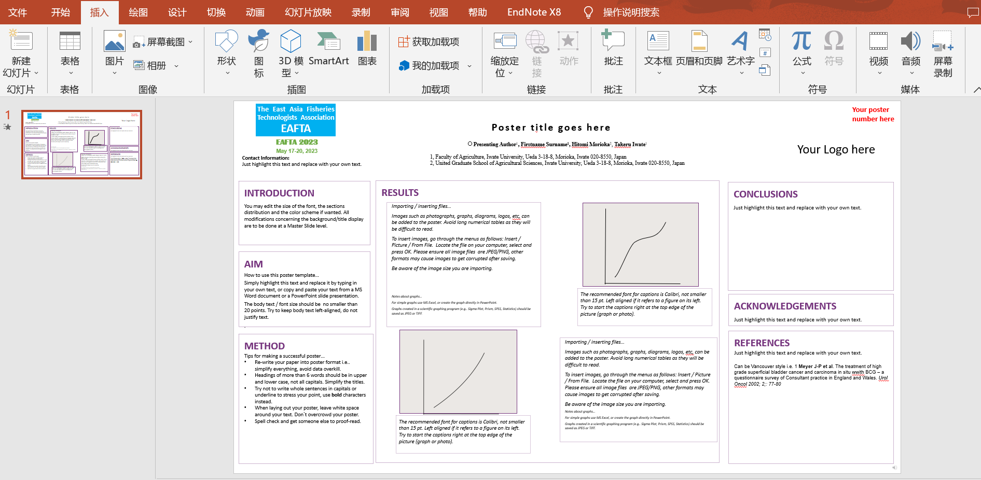
1. Insert
2. Audio

Slide 2
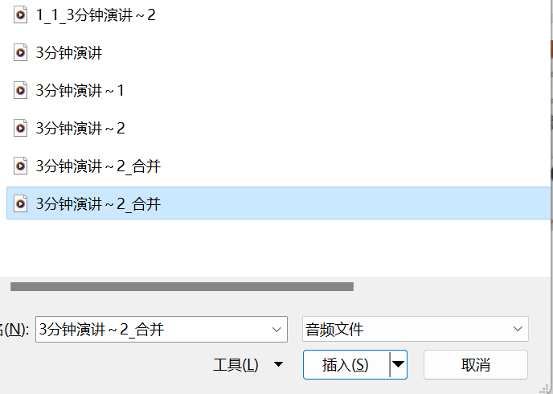
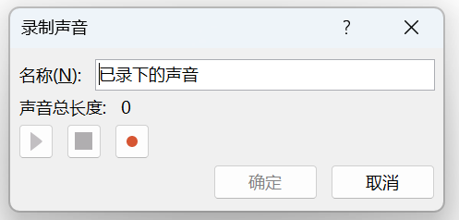
3. You can choose to insert pre-recorded audio (we recommend),
or record directly in the interface of making slideshows.
Record directly
Searching pre-recorded audio (we recommend)

Slide 3
4. Complete and take an audio test.

